Slide 1
CAPSTONE PROJECT
BY NANA HAMZAT

Slide 2
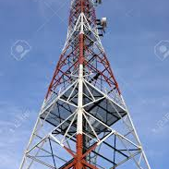
PROBLEM STATEMENT
A new internet service provider (TELNEL) wants to open its first office in the heart of Toronto alongside its High priority base station. Our target location is generally a busy spot where there are lots of active daily routines and business activities.

Slide 3
Data Collected
Wikipedia : To obtain different borough or district,the location data for Canada was scrapped from https://en.wikipedia.org/w/index.php?title=List_of_postal_codes_of_Canada:_M&oldid=942851379
Foursquare: The foursquare API was used to generate geolocation information about the venues in each Borough.
Geographical Coordinates: The latitude and longitude for each location was generated via https://cocl.us/Geospatial_data.

Slide 4
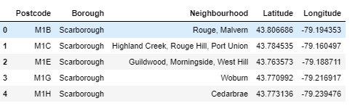
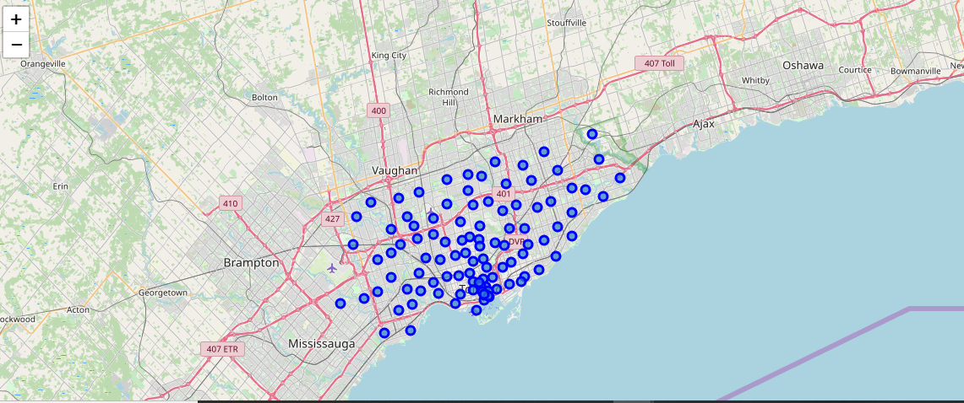
Methodology
The dataframe in Fig 1 as shown consisting of the post code, Borough, Neighborhood, Latitude and Longitude was generated.
Fig 1
Using Folium library the map of Toronto was generated with each neighborhood marked as blue as shown in Fig II
Fig II

Slide 5
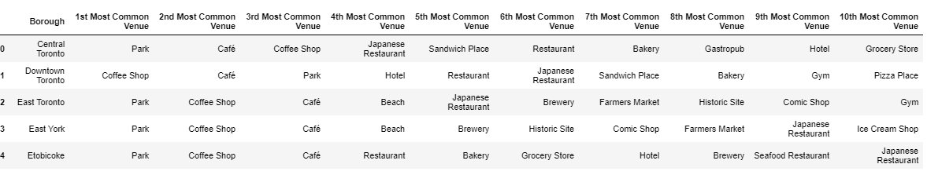
Methodology continued
Foursquare API is used to search for 100 top venues across all boroughs within the radius of 10km. 206 unique categories were found.
Then the venues were limited to the 10 most common venues in all Borough.
Fig III

Slide 6
CLUSTERING
All Boroughs with the same were splitted into 5 different clusters using K-Means.

Slide 7
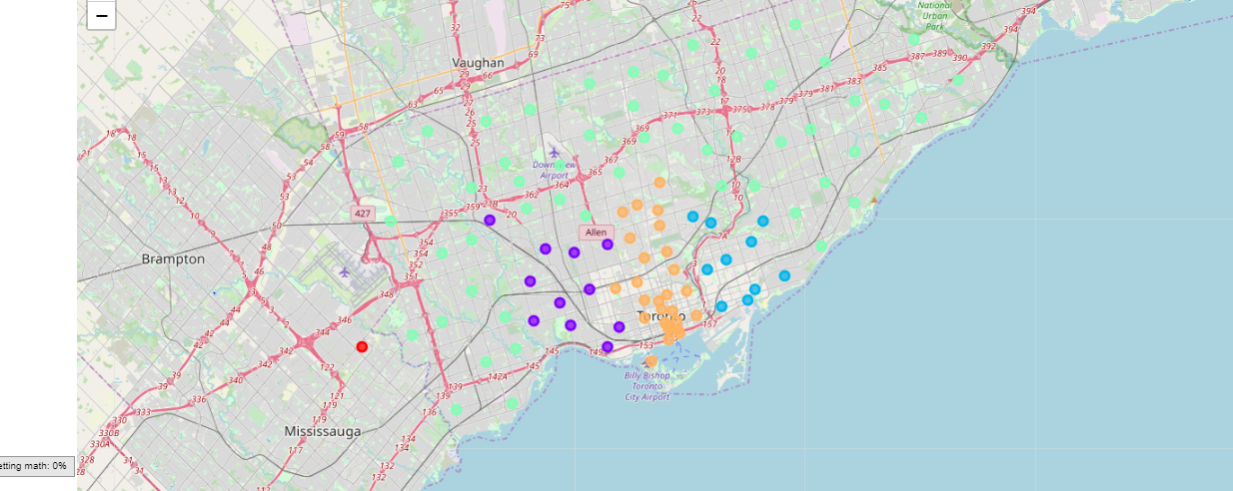
Result
It can be deduced that cluster 5 which is marked green on the map has more venues dominated in its cluster. It has two Boroughs named Central Toronto and Downtown Toronto.

Slide 8
Conclusion
Downtown Toronto has more venues than that of Central Toronto and thus more activities. Therefore , it can be deduced that Downtown Toronto is the best venue to for TELNEL to build her Office and build more base stations in that area due to increase in the network traffic.

